Slide 1
CSCI1540 Fundamental Computing with C++
Fundamental Data Types
Fall, 2019

Slide 2
Questions to be Answered…
How large/small can integers and floating point numbers be?
Why 2.1 - 2.0 - 0.1 is not zero? 😱
How should you evaluate 3.1 + 4 / 3?
What happens when you assign a floating point number to an int variable?
How can you represent ♠♥♣♦ in a card game program?

Slide 3
Outline
Integers
Integer Overflow
Floating Point Numbers
Precision and Range
Type Conversion
Coercion (Implicit Type Conversion)
Casting (Explicit Type Conversion)
Representing Other Types of Data

Slide 4
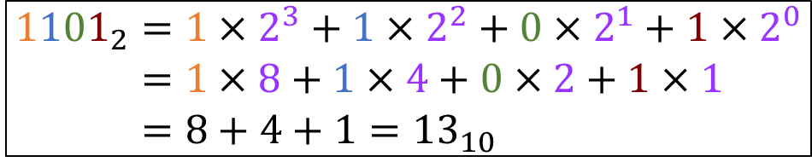
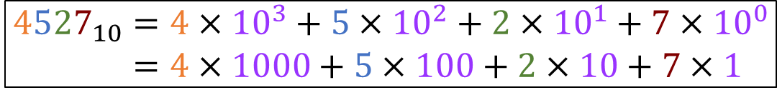
1. Integers
Computers represent integers as binary numbers
Decimal (base 10) systems: digits 0, 1, 2, …, 9
E.g.:
Binary (base 2) systems: digits 0, 1
E.g.:
$${4527}_{10}=4×{10}^{3}+5×{10}^{2}+2×{10}^{1}+7×{10}^{0} \\ =4×1000+5×100+2×10+7×1$$
$${1101}_{2}=1×2^{3}+1×2^{2}+0×2^{1}+1×2^{0} \\ =1×8+1×4+0×2+1×1 \\ =8+4+1={13}_{10}$$

Slide 5
1.1 Decimal → Binary Conversion
How does a computer represent 18₁₀?
Dividing the number by 2. Obtain the remainder
2
2
2
2
2
18
9
4
2
1
0
— 0
— 1
— 0
— 0
— 1
Read the remainders bottom up to get the binary representation of 18, which is 10010₂
Keep dividing the number by 2
Keep dividing the number by 2 until it becomes zero
As a 32-bit integer, 18 is represented as:
00000000 00000000 00000000 00010010

Slide 6
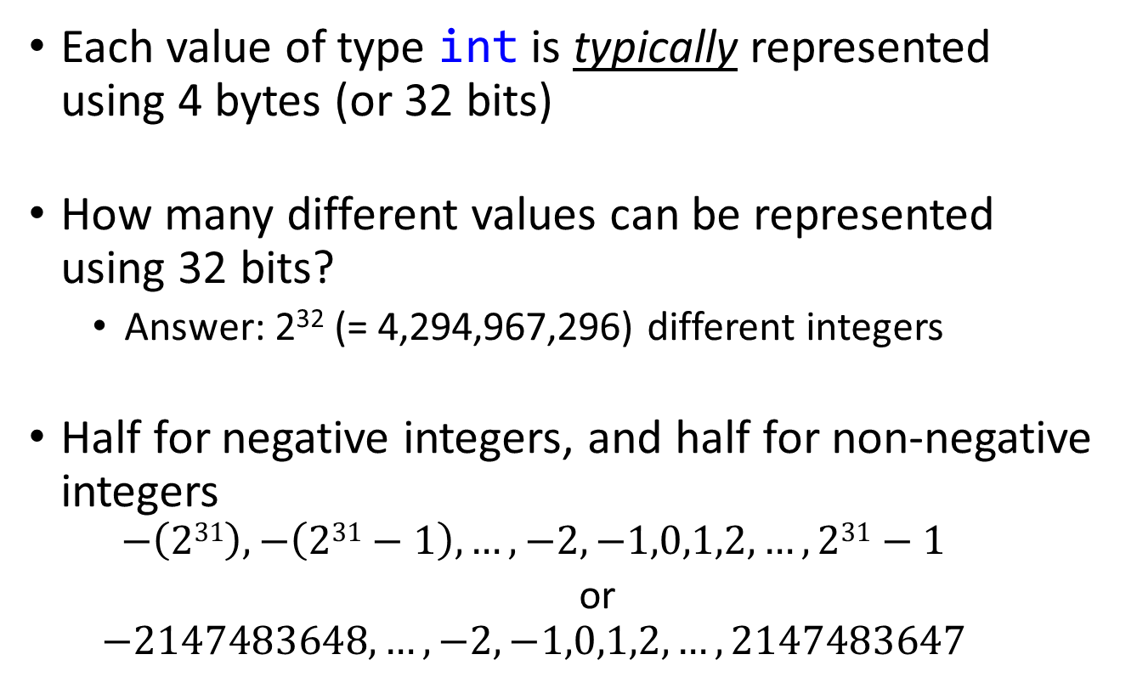
1.2 Number of Bits vs Integer Range
Each value of type int is typically represented using 4 bytes (or 32 bits)
How many different values can be represented using 32 bits?
Answer: 2³² (= 4,294,967,296) different integers
Half for negative integers, and half for non-negative integers
$$−\left(231\right),−\left(231−1\right),…,−2,−1,0,1,2,…,231−1$$
or
$$−2147483648,…,−2,−1,0,1,2,…,2147483647$$

Slide 7
1.3 Representing +ve and –ve Integers
Two’s Complement: a binary number representation that can represent both +ve and –ve integers. It involves two steps:
Bitwise negation (1 ↔ 0)
Plus 1 (+1)
Example: –18 and 18 as 8-bit integers
00010010 (= 18₁₀)
(1 ↔ 0) ↕↕↕↕↕↕↕↕
11101101
(+1) + 1
2’s complement: 11101110 (= –18₁₀)
11101110 (= –18₁₀)
↕↕↕↕↕↕↕↕
00010001
+ 1
00010010 (= 18₁₀)

Slide 8
1.3 Representing +ve and –ve Integers
In 2’s complement, all –ve numbers have 1 as the most significant (left-most) digit
E.g., for 8-bit integers:
00000000 = 0
11111111 = –1
10000000 = –128
01111111 = 127
E.g., for 32-bit integers:
11111111 11111111 11111111 11111111 = –1
00000000 00000000 00000000 11111111 = 255
10000000 00000000 00000000 00000000 = –2147483648
01111111 11111111 11111111 11111111 = 2147483647

Slide 9
1.3 Representing +ve and –ve Integers
Another view of 2’s complement
8-bit 2’s Complement | Decimal
00000000 | 0
00000001 | 1
00000010 | 2
… | …
01111110 | 126
01111111 | 127
10000000 | –128
10000001 | –127
10000010 | –126
… | …
11111110 | –2
11111111 | –1
32-bit 2’s Complement | Decimal
00000000 00000000 00000000 00000000 | 0
00000000 00000000 00000000 00000001 | 1
00000000 00000000 00000000 00000010 | 2
⋮ | ⋮
01111111 11111111 11111111 11111110 | 2147483646
01111111 11111111 11111111 11111111 | 2147483647
10000000 00000000 00000000 00000000 | –2147483648
10000000 00000000 00000000 00000001 | –2147483647
10000000 00000000 00000000 00000010 | –2147483646
⋮ | ⋮
11111111 11111111 11111111 11111110 | –2
11111111 11111111 11111111 11111111 | –1

Slide 10
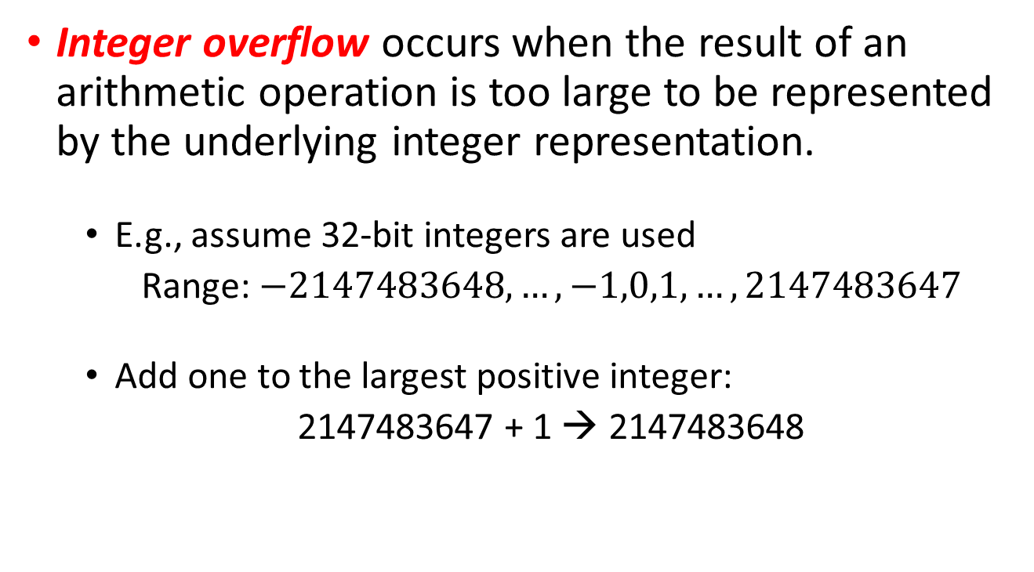
1.4 Integer Overflow
Integer overflow occurs when the result of an arithmetic operation is too large to be represented by the underlying integer representation.
E.g., assume 32-bit integers are used
Range: $−2147483648,…,−1,0,1,…,2147483647$
Add one to the largest positive integer:
2147483647 + 1 → 2147483648
Overflow!

Slide 11
Integer Overflow: Example
1
2
3
4
5
6
7
8
9
10
11
12
13
14
#include <iostream>
#include <climits> // For using INT_MAX
using namespace std;
int main() {
int x = INT_MAX; // Maximum value of an int
cout << "Before: " << x << endl;
x++;
cout << "After: " << x << endl;
return 0;
}
Before: 2147483647
After: -2147483648

Slide 12
1.5 C++ Built-in Integral Types
Why we need so many different integer types?
Type | Size (in bytes) [VS] | Range
short (or short int) | 2 | –2¹⁵ … 2¹⁵ – 1 (-32,768 … 32,767)
int | ≥ 2 [4] | –2³¹ … 2³¹ – 1 (if 4 bytes) (–2,147,483,648 … 2,147,483,647)
long (or long int) | ≥ 4 [4] | –2⁶³ … 2⁶³ – 1 (if 8 bytes) (–9,223,372,036,854,775,808 … 9,223,372,036,854,775,807)
unsigned short | 2 | 0 … 2¹⁶ – 1 (0 … 65535)
unsigned int (or unsigned) | ≥ 2 [4] | 0 … 2³² – 1 (if 4 bytes) (0 … 4,294,967,295)
unsigned long | ≥ 4 [4] | 0 … 2⁶⁴ – 1 (if 8 bytes) (0 … 18,446,744,073,709,551,615)
VS: Visual Studio

Slide 13
2. Floating Point Numbers
Floating point numbers and integers have different representations
E.g., decimal number 13.6875₁₀:
A computer allocates some bits to store the mantissa and some bits to store the exponent
13.6875₁₀
= 1101.1011₂
= 0.11011011₂ × 2⁴
See conversion on next page
Mantissa
Exponent

Slide 14
2.1 Decimal → Binary Conversion
How does a computer represent 0.6875₁₀?
Multiply the number by 2. Obtain the integer part
0.6875
× 2
1.3750
× 2
0.7500
× 2
1.5000
× 2
1.0000
Read the integer parts top to bottom to get the binary representation of 0.6875, which is 0.1011₂
Keep multiplying the fractional part by 2
Keep multiplying the fractional part by 2 until it becomes zero

Slide 15
2.2 IEEE 754 Standard
13.6875₁₀ = 1101.1011₂ = 0.11011011₂ × 2⁴
Single precision: data type float (32-bit)
Sign (+/−): 1 bit
Mantissa: 23 bits
Exponent: 8 bits
Double precision: data type double (64-bit)
Sign (+/−): 1 bit
Mantissa: 52 bits
Exponent: 11 bits
Mantissa
Exponent
sign
exponent
mantissa
sign
exponent
mantissa

Slide 16
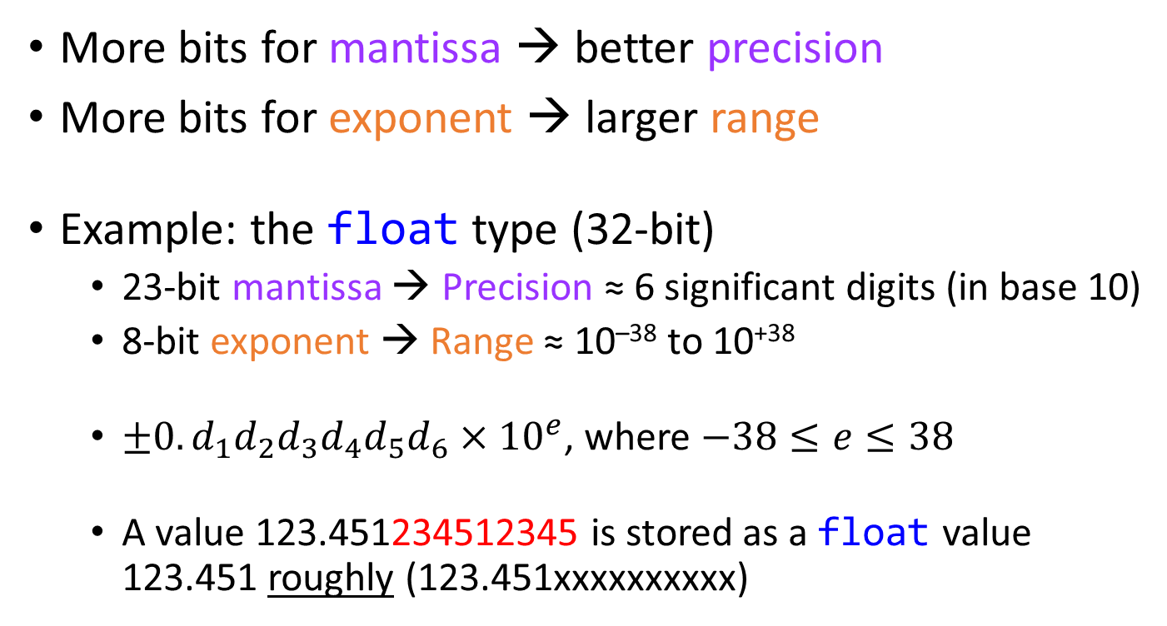
2.3 Precision and Range
More bits for mantissa → better precision
More bits for exponent → larger range
Example: the float type (32-bit)
23-bit mantissa → Precision ≈ 6 significant digits (in base 10)
8-bit exponent → Range ≈ 10^{–38} to 10⁺³⁸
$±0.d_{1}d_{2}d_{3}d_{4}d_{5}d_{6}×{10}^{e}$, where $−38≤e≤38$
A value 123.451234512345 is stored as a float value 123.451 roughly (123.451xxxxxxxxxx)

Slide 17
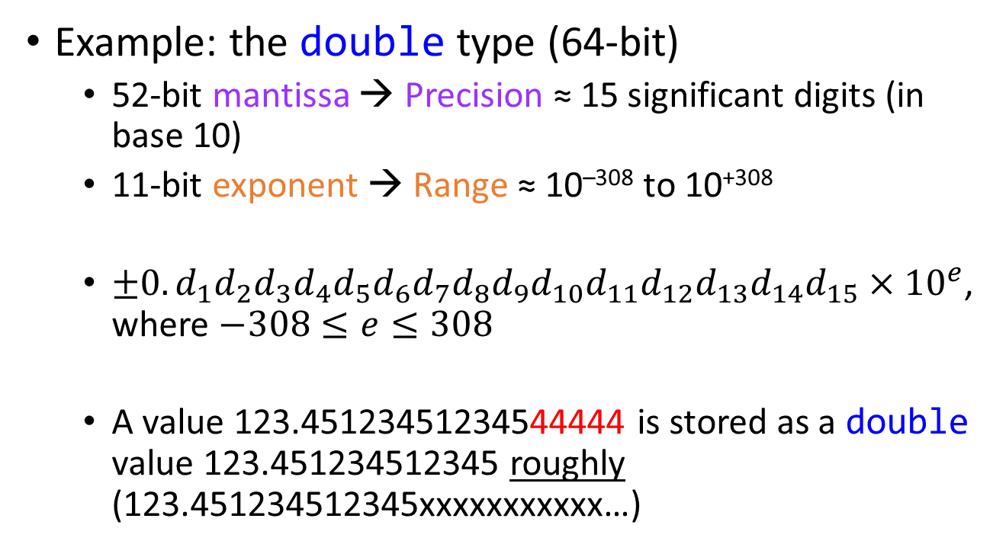
2.3 Precision and Range
Example: the double type (64-bit)
52-bit mantissa → Precision ≈ 15 significant digits (in base 10)
11-bit exponent → Range ≈ 10^{–308} to 10⁺³⁰⁸
$±0.d_{1}d_{2}d_{3}d_{4}d_{5}d_{6}d_{7}d_{8}d_{9}d_{10}d_{11}d_{12}d_{13}d_{14}d_{15}×{10}^{e}$, where $−308≤e≤308$
A value 123.45123451234544444 is stored as a double value 123.451234512345 roughly (123.451234512345xxxxxxxxxxx…)

Slide 18
2.4 Characteristics of Floating Point Numbers
Not all real numbers are representable (even when they are within the range)
Limited number of bits to represent mantissa and exponent
When a number is not representable, it is rounded to the nearest representable floating point number
E.g., 123.45123451234544444 → 123.451234512345 (roughly)

Slide 19
2.4 Characteristics of Floating Point Numbers
Floating point arithmetic operations may not be exact
Try this:
1
2
3
4
5
6
7
8
float a = 111111.0, b = 0.1, c;
c = a + b;
cout.precision(15); // Set printing at most 15 digits
cout << a << endl;
cout << b << endl;
cout << c << endl;
As a result, the checking
a + b == 111111.1
would be false 😱😱😱
Avoid comparing floating point numbers for equality!
111111
0.100000001490116
111111.1015625

Slide 20
2.4 Characteristics of Floating Point Numbers
Repeating
0.1₁₀ = 0.1100110011001100110011001100…₂ × 2^{–3}
Round to 24th place
≈ 0.110011001100110011001101₂ × 2^{–3}
= 0. 100000001490116119384765625₁₀
float a = 111111.0, b = 0.1, c;
c = a + b;
cout.precision(15);
cout << a << endl;
cout << b << endl;
cout << c << endl;
float b = 0.1;
if (b == 0.1)
cout << "Yes";
else
cout << "No";
No
111111
0.100000001490116
111111.1015625

Slide 21
2.5 C++ Built-in Floating Point Types
Type | Size (in bytes) [VS] | Range
float | 4 | ±3.4 × 10^{±38} (~6 significant digits)
double | 8 | ±1.7 × 10^{±308} (~15 significant digits)
long double | ≥ 8 [8]
Using int for integers and double for floating point numbers would serve usual and common programming needs.
But you still need to choose a suitable data type when you encounter special scenarios
VS: Visual Studio

Slide 22
3. Mixing Data Types in Expressions
HK$1000 + JP¥10000 → ?
3.1 + 2 → ?
4.0 == 4 → true or false?
double d = 4; What value will d hold?
int x = 4.1; What value will x hold?
Some kind of conversions is needed to ensure the type of both operands are compatible before we can evaluate the expressions
There are two kinds of type conversions in C++:
Coercion and casting

Slide 23
3.1 Implicit Type Conversion
C++ has a set of conversion rules to resolve certain mismatched operand types
As a convenience to programmers, compilers automatically convert the value of the operands from one type to another based on these rules whenever possible
Implicit type conversion a.k.a. coercion

Slide 24
3.1.1 Arithmetic Conversion Rules (Simplified)
If either operand is a double, the other is converted to double. The result type is also double
E.g.:
3.1 + 2 (3.1, by default, is of type double)
→ 3.1 + 2.0 (2 is converted to 2.0, of type double)
→ 5.1 (Result is also of type double)
If both operands are integral types (char, short, int), then both operands are converted to int. The result type is also int. (E.g.: true + true → 1 + 1 → 2)
For logical and relational operators, the result type is always bool. (E.g.: 1 && 2 → true)

Slide 25
3.1.2 Floating ↔ Integral Types (Simplified)
Converting integral type to double is typically safe
No warning is given at compile time
E.g.: double d = 4; // 4 converted to 4.0
Converting double to integral type may result in loss of data
If the number is within the range of the integral type, the fractional part is truncated
Compiler usually warn at compile time. (No guarantee)
E.g.:
int x = 4.1; // 4.1 converted to 4
x = 2 * 4.1; // 8.2 converted to 8
x = 12345678901.2; // Behavior undefined

Slide 26
3.2 Explicit Type Conversion (Casting)
Suppose you want to perform
double d = 4.0;
int x = d;
But you don’t want a compilation warning (possible loss of data). What can you do?
You can request explicit conversion using “type-casting”:
x = (int)d;
Converts the value of d to an “equivalent” value of type int

Slide 27
3.2.1 Type Casting Operators: Three Syntaxes
static_cast<new_type>(expr)
One of the specialized casting operators introduced in C++
The parentheses around expr is required
new_type(expr)
C++-style casting
(new_type)expr
C-style casting
All of them convert the value of expr to the equivalent value of type new_type
x = static_cast<int>(d); // 1
x = int(d); // 2
x = (int)d; // 3

Slide 28
3.2.1 Typecasting: Example
Example: average of n integers
Consider the following declarations:
Suppose we have obtained the value of n and calculated the total of n integers
Which of these will correctly calculate the average?
int total, n;
double avg;
avg = total / n; // A
avg = (double)total / n; // B
avg = total / (double)n; // C
avg = (double)(total / n); // D
avg = (double)total / (double)n; // E

Slide 29
3.3 How are Data Converted? (Both Coercion and Casting)
Floating types → integral types
Only retain the integer part (no rounding)
E.g.:
int x = (int)4.9; // x gets 4
int y = (int)-3.99; // y gets -3
Larger integer types → smaller integer types
Retain only the least significant bits
E.g., 32-bit integer (int) to 16-bit integer (short):
32-bit (int): 0000000000000010 0000000000000011 = 131075₁₀
16-bit (short): 0000000000000011 = 3₁₀
short x = (short)131075; // x becomes 3

Slide 30
3.4 Coercion vs Casting
Implicit Type Conversion (Coercion)
The target type is selected according to some rules
// Implicitly convert true to 1 (bool -> int)
cout << (true / 2); // Output 0
Compilers may warn if conversion is unsafe
Explicit Type Conversion (Casting)
Programmers have control over what the target type is
// Explicitly convert true to 1.0 (bool -> double)
cout << ((double)true / 2)); // Output 0.5
Compilers won’t warn even if loss of data is possible
Not every type conversion is possible

Slide 31
Why is Knowing “Type Conversion” Important?
To be able to express and evaluate mixed-type expressions correctly
3.1 + 2 → ?
4.0 == 4 → true or false?
(int)(4 / 3.0) → ?
1234 == "1234" Is this possible?
1234 == (int)"1234" How about this?
true == 1.0 Is this possible?

Slide 32
4. Representing Other Types of Data
How can you represent
Suits of playing card: ♠♥♣♦?
Fruits: apple, orange, banana, pineapple, etc.?
Dates?
C++ has no built-in types to represent these data
Solution: Using integers, floating point numbers, character, Boolean, string, or their combinations

Slide 33
Representing ♠♥♣♦ (v1)
1
2
3
4
5
6
7
8
9
10
11
12
13
#include <iostream>
using namespace std;
/* Use integer to represent the 4 different suits
Spade = 1, Heart = 2, Club = 3, Diamond = 4 */
int main() {
int mySuit = 4; // mySuit is a diamond
if (mySuit == 1)
cout << "Spade"; /* Print this to represent spade
or draw one if you know how */
…
This is just one of many possible representations

Slide 34
Representing ♠♥♣♦ (v2)
Defining named constants
(Using SPADE/HEART/CLUB/DIAMOND is more meaningful than using 1/2/3/4)
1
2
3
4
5
6
7
8
9
10
11
12
13
14
15
#include <iostream>
using namespace std;
const int SPADE = 1;
const int HEART = 2;
const int CLUB = 3;
const int DIAMOND = 4;
int main() {
int mySuit = DIAMOND; // mySuit is a diamond
if (mySuit == SPADE)
cout << "Spade"; /* Print this to represent spade
or draw one if you know how */
…
Must be initialized by a constant in the declaration
Their values cannot be modified later in the program
Convention: name them using all uppercase letters to distinguish from normal variables
Can be declared outside main() to make them globally accessible. (But do not declare normal variables outside functions)

Slide 35
Representing ♠♥♣♦ (v3)
(Optional)
Define a new enumerated type called SuitType with four named constants as its possible values
1
2
3
4
5
6
7
8
9
10
11
12
13
#include <iostream>
using namespace std;
enum SuitType { SPADE=1, HEART=2, CLUB=3, DIAMOND=4 };
int main() {
SuitType mySuit = DIAMOND; // mySuit is a diamond
cout << mySuit << endl; // Prints 4 (coercion)
mySuit = 3; // Compilation error: 3 is not of SuitType
cin >> mySuit; /* Compilation error: cin cannot
handle SuitType */
…
Using enumerated type is safer but more restrictive than using int directly

Slide 36
Representing Date
Using 3 integers
Need 3 variables for every date
Using one string (E.g., "20140928")
Not easy to manipulate or extract the day, month, year from a string
Using one integer 💭
One possibility: In the form yyyymmdd (Any overflow?)
E.g., 20181225 represents ’Xmas of 2018
Using a class or a structure type
A user-defined type
Can be defined as a combination of other types.
(Will be introduced when we discuss OOP later)

Slide 37
Can You Answer These Questions Now?
What's the largest integer you can store in a variable of type short (2-byte signed integers)?
Is 2.2 - 1.1 == 1.2 - 0.1 true or false?
Is 3.1 * 4 % 3 a valid expression? Why?
Suppose x is a variable of type int. What is the difference between writing
x = 3.14;
and
x = (int)3.14;

Slide 38
Summary
Be aware of the range of different integral types to avoid integer overflow
Understand the limitation of floating point types
Inexactness of floating point representation and arithmetic
Know the underlying conversions when evaluating expressions containing values of different types
Know how to pick a suitable data type for your program
Know how to represent ad-hoc data in programs
Next: Functions

